Slide 1
VMware Container Workshop
Level 1 & 2
February 2018

Slide 2
Meet Greet, Current State Interview Introduction to Docker and Containers Hands-On Sessions
Resume Introduction to Docker and Containers Storage Hands-On Sessions
Developer and Operator Workflows ​CI/CD Using Docker
Swarm Coverage Kubernetes Coverage Request Session Feedback
Day 1
Day 2
Day 3
Day 4

Slide 3
Meet Greet, Current State Interview Introduction to Docker and Containers
Resume Introduction to Docker and Containers Hands-On Sessions Kubernetes Coverage Request Session Feedback
Day 1
Day 2

Slide 4
Introduction to Docker and Containers
Hours 1 & 2
Docker 30,000ft overview
Our training environment
Installing Docker
Our first containers
Background containers
Restarting and attaching to containers
Hours 3 & 4
Understanding Docker images
Building images interactively
Building Docker images with a Dockerfile
CMD and ENTRYPOINT
Copying files during the build
Multi-stage builds
Publishing images to the Docker Hub
Tips for efficient Dockerfiles

Slide 5
Introduction to Docker and Containers
Hours 3 & 4
Understanding Docker images
Building images interactively
Building Docker images with a Dockerfile
CMD and ENTRYPOINT
Copying files during the build
Multi-stage builds
Publishing images to the Docker Hub
Tips for efficient Dockerfiles

Slide 6
Goals for this workshop
After this workshop you should have a firm understanding of
What containers are good for
Why you would use them
How you use them
Why you would want to orchestrate containers
How you orchestrate them

Slide 7
Expectations
This is the first time we have run this workshop:
please give us detailed feedback at the end of the day or week
Ask questions any time!
Come and go based on your level of understanding
Feel free to get into the weeds of your particular use cases
Slow me down if we are going to fast
Speed me up if we are going too slow

Slide 8
Primary Training Materials
Toward the goal supporting great open source learning materials, we will be leveraging and contributing to the excellent Containers Workshop slides originally created by Jérôme Petazzoni and currently run with Bret Fisher which can be found in original source form at
https://github.com/jpetazzo/container.training/
That content is also hosted live at http://container.training/
The instructions and slides in that repository (e.g. the files with extension .md and .yml in the "slides" subdirectory) are under the Creative Commons Attribution 4.0 International Public License. You may obtain a copy of this license at:
https://creativecommons.org/licenses/by/4.0/legalcode

Slide 9
Hands-On Materials
We have created materials for running the hands on portions of this workshop
Clone or download code from:
https://github.com/tompscanlan/vmware-container-workshop
We will reference this repository throughout the workshop

Slide 10
Hands-On With vSphere Integrated Containers
Group use of a single virtual container host
During this workshop we will use a single virtual container host (VCH)
A team would use a single VCH to run pre-production tests or production workloads
To avoid conflicts when we are all running the same operations, append your email username to any named resources:
Docker run –name common-name-emailID

Slide 11
Install Pre-reqs
If you will be building the hands-on tasks, install task: https://github.com/go-task/task#installation
If doing the hands-on, you’ll probably want to install git, otherwise download zip files of repositories as needed: https://git-scm.com/book/en/v2/Getting-Started-Installing-Git
Install a local copy of Docker on your laptop, or run a VM that has Docker installed. The following slides detail that process.

Slide 12
Get a Docker Endpoint
We don’t really care how!
For Exploring:
https://labs.play-with-docker.com/
https://labs.play-with-k8s.com/
For Development:
apt-get install …
yum install …
MacOS Docker
Windows Docker

Slide 13
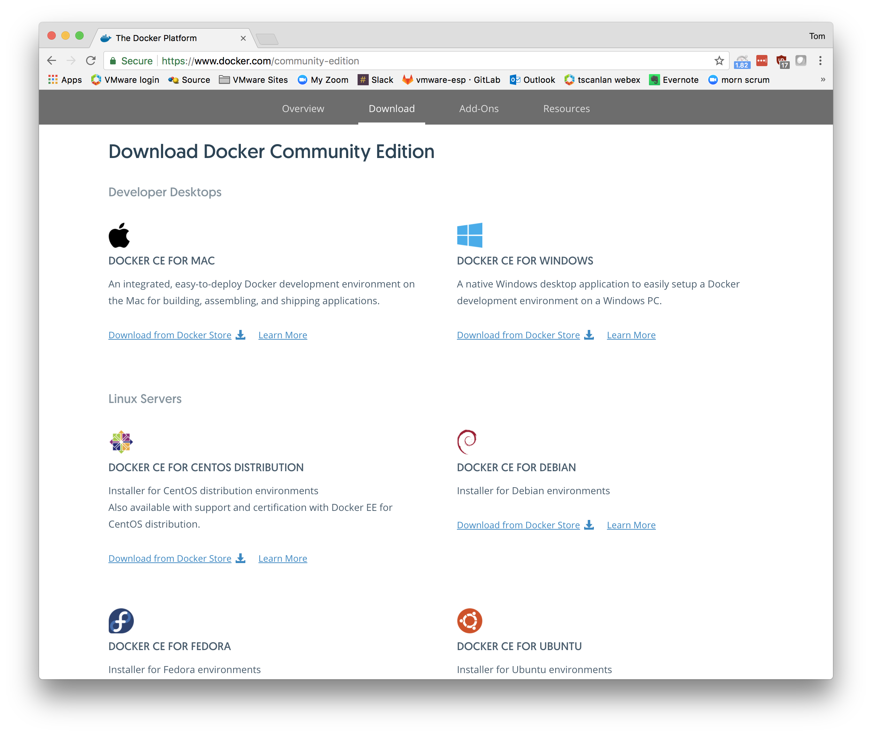
Install Docker Locally
Spend the next 15 minutes installing Docker on your laptop or in a Linux VM.
Open a browser to docker.com and find the download link.
When you can run “docker info” you are done.

Slide 14
Verify it is working
Take a brief break while others finish
You are done when
docker version
and
docker info
give you interesting results

Slide 15
Get a Docker Endpoint for Deployment
Operations sets this up for developers
For Deployment: ./vic-machine-darwin create --name testing \ --container-name-convention testing-{name} \ --compute-resource /Goddard/host/Home \ --image-store vms/testing \ --base-image-size 8GB \ --volume-store vms/testing-volumes:default \ --bridge-network bridge-vic1 \ --bridge-network-range 172.16.0.0/12 \ --public-network VMNet \ --public-network-ip 192.168.1.202/24 \ --public-network-gateway 192.168.1.254 \ --dns-server 192.168.1.17 \ --dns-server 8.8.8.8 \ --tls-cname 192.168.1.202 \ --certificate-key-size 2048 \ --user administrator@vsphere.local \ --thumbprint "06:AE:8D:80:A6:88:7E:6B:D3:74:85:F2:93:B6:92:9E:4C:99:8C:1D" \ --target vcenter.home.local/Goddard \ --registry-ca ~/Downloads/ca.crt \ --ops-user administrator@vsphere.local

Slide 16
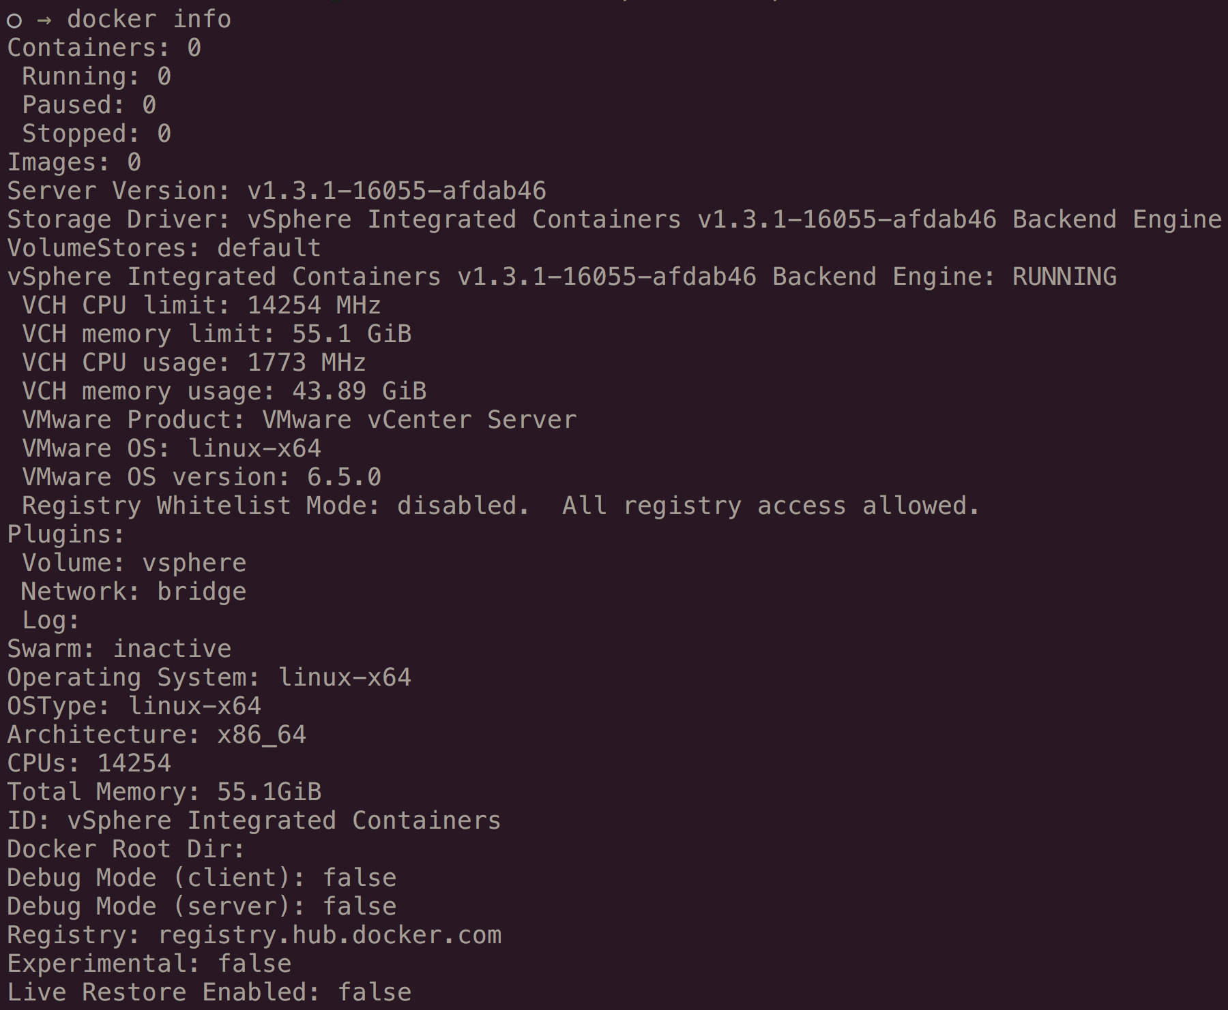
Check the VCH Docker Endpoint
The endpoint is probably using TLS If you get the error:
* Are you trying to connect to a TLS-enabled daemon without TLS?
To check on a Docker endpoint run
docker -H 192.168.1.202:2376 info
May need to add –tlsverify and a cert path if using TLS
We can eliminate the need to specify a host, cert path, and TLS verification on every command line by using environment variables:
export DOCKER_HOST=192.168.1.202:2376
export DOCKER_CERT_PATH=~/vch-testing
export DOCKER_TLS_VERIFY=1

Slide 17
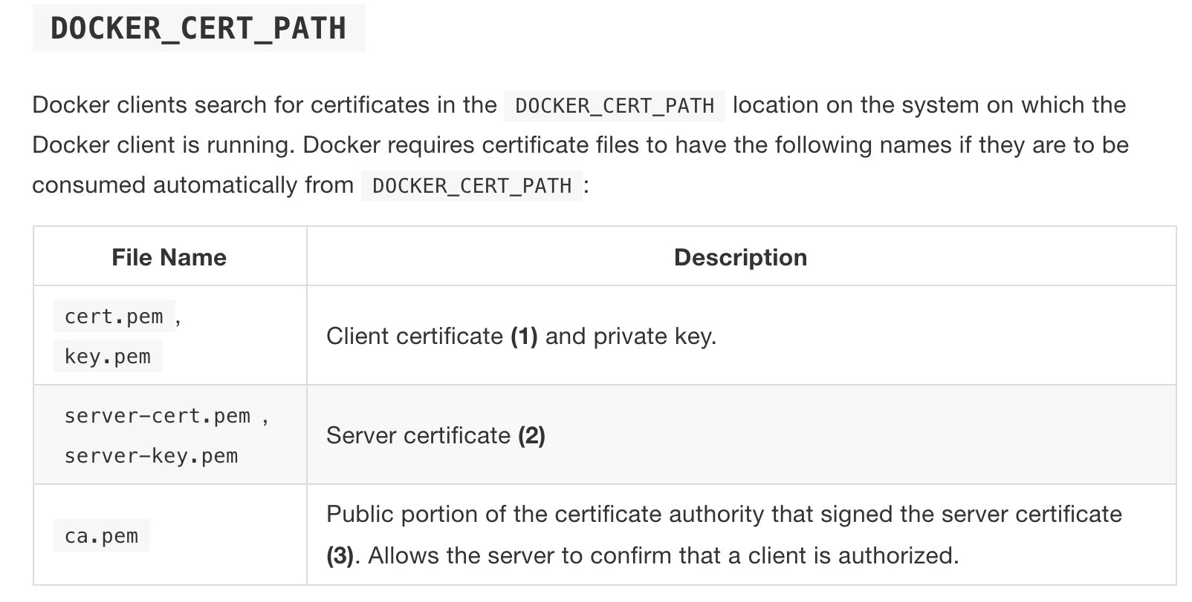
Certificates
Non-TLS Docker connections should not be allowed in production
When creating a VCH, all the needed certificates are either generated or provided by the operator
If using a standard Docker host, these certificates will need to be created
From: https://vmware.github.io/vic-product/assets/files/html/1.3/vic_vsphere_admin/vch_security.html

Slide 18
Docker Introduction

Slide 19
Head to http://container.training/intro-fullday.yml.html
We will follow the content there and circle back for hands-on labs

Slide 20
Why Use Docker?
The process of developing software has improved
From:
Large Monolithic Applications
Long Development Cycles, Waterfall Development
Painful Deployments
To:
Service Oriented Architectures or Microservices
Small Development Cycles, Always Deliverable Product
Easy Deployments Done Frequently

Slide 21
Why Use Docker?
Software Delivery
We used to ship
Tarballs
RPM
Jar/War
AMIs
And run them in
Laptop
Development Server
Test Server
Production Server
Each with it’s own unique configuration.
Becomes dependency hell!

Slide 22
Why Use Docker?
Standardization
Docker exposes a unified framework for dealing with that complexity
Bundle the application
Bundle any dependent libraries or binaries, everything but the kernel
Enable efficient delivery of the specific bundles needed
Ensure that that workflow for running the application is
the same everywhere
simple to understand
No more:
Works On My Box!
Management of multiple versions of various software stacks
Digging through code to figure out how to run the application

Slide 23
After Docker
Avoid Dependency Related Failures
Onboard Developers Quickly: no more days long setup
Developers Can Switch Projects With Ease
Continuous Integration Becomes Easy
Delivery Process is the Same Everywhere

Slide 24
Containers Aren’t New
Containers have been done before:
Linux vServer
Solaris Zones
FreeBSD Jails
Virtuozzo/OpenVZ
LXC (linux containers)
Docker just puts all the tools together to make it easy to consume
No more homegrown PAAS solutions translates to faster to market

Slide 25
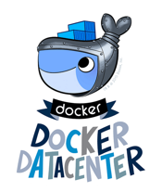




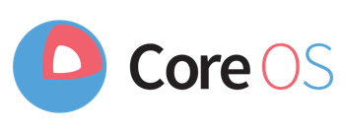



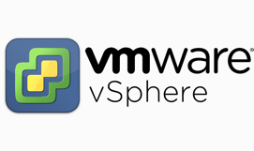
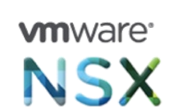
Layered View
Developer
Layer 6: Application
Layer 5:
Orchestration / Scheduling
Layer 4: Container Engine
Operations
Layer 3: Operating System
Layer 2: Virtual Infrastructure
VSAN
Layer 1: Physical Infrastructure
Compute
Network
Storage

Slide 26
Docker Objects
Image
A layered file system that contains all the application code packaged with all dependencies other than the kernel and kernel drivers
An isolated and controlled version of an application, usually generated as a result of the software development lifecycle
Metadata related to command to run, ports and volumes to use
Container
An instance of an image, usually pulled from a registry
Can be used like a process (start, stop, restart, kill…)
Isolated from other containers at the process level
Dockerfile
A textual definition of the composition of an image
Used to build an image
Registry
A service for storing and downloading layers of desired images

Slide 27
What is an Image?
Image from https://www.docker.com/what-container

Slide 28
What is a Container?
What?
Lightweight packaging of applications
Stand-alone bundle that includes an application, all libraries, tools, and settings needed to run it
Enables Windows or Linux Application Stacks
OS-level Isolation
Isolation at individual kernel subsystem level (e.g. filesystem, process table, etc)
User-level process (LXC, libcontainer) orchestrates these subsystems to create a container
Existed for Many Years
Linux vServer, Solaris Zones, FreeBSD Jails, Virtuozzo/OpenVZ, AIX 6.1 WPARs, HPUX SRP, LXC, VMware ThinApps, etc.
Why?
Process isolation
Lightweight
Reproducible environment
Enables management at scale
Better development and deployment workflow
Image from https://www.docker.com/what-container

Slide 29
What is a Dockerfile?
Image from https://www.docker.com/what-container

Slide 30
What is a Registry?
Image from https://www.docker.com/what-container

Slide 31
Docker Components
https://docs.docker.com/engine/docker-overview/#the-docker-platform

Slide 32
Initial Hands-On with Docker
Go to https://goo.gl/gndfKc

Slide 33
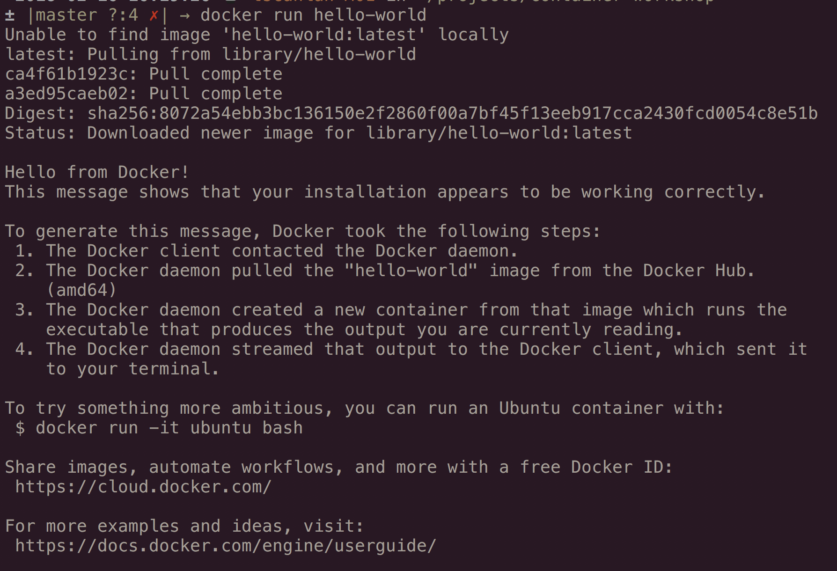
Running Basic Containers
docker run hello-world

Slide 34
Running single command and get output

Slide 35
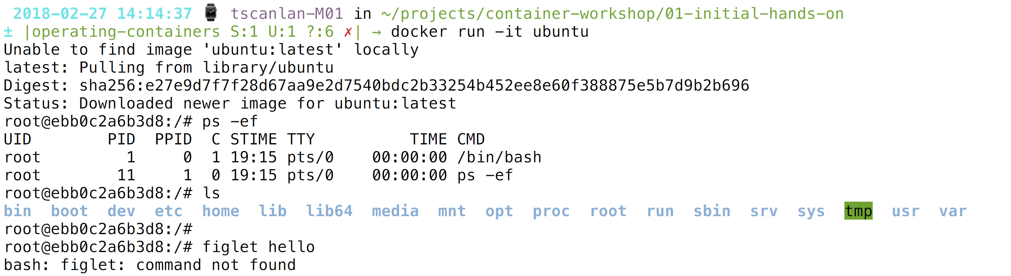
Run an OS as a container

Slide 36
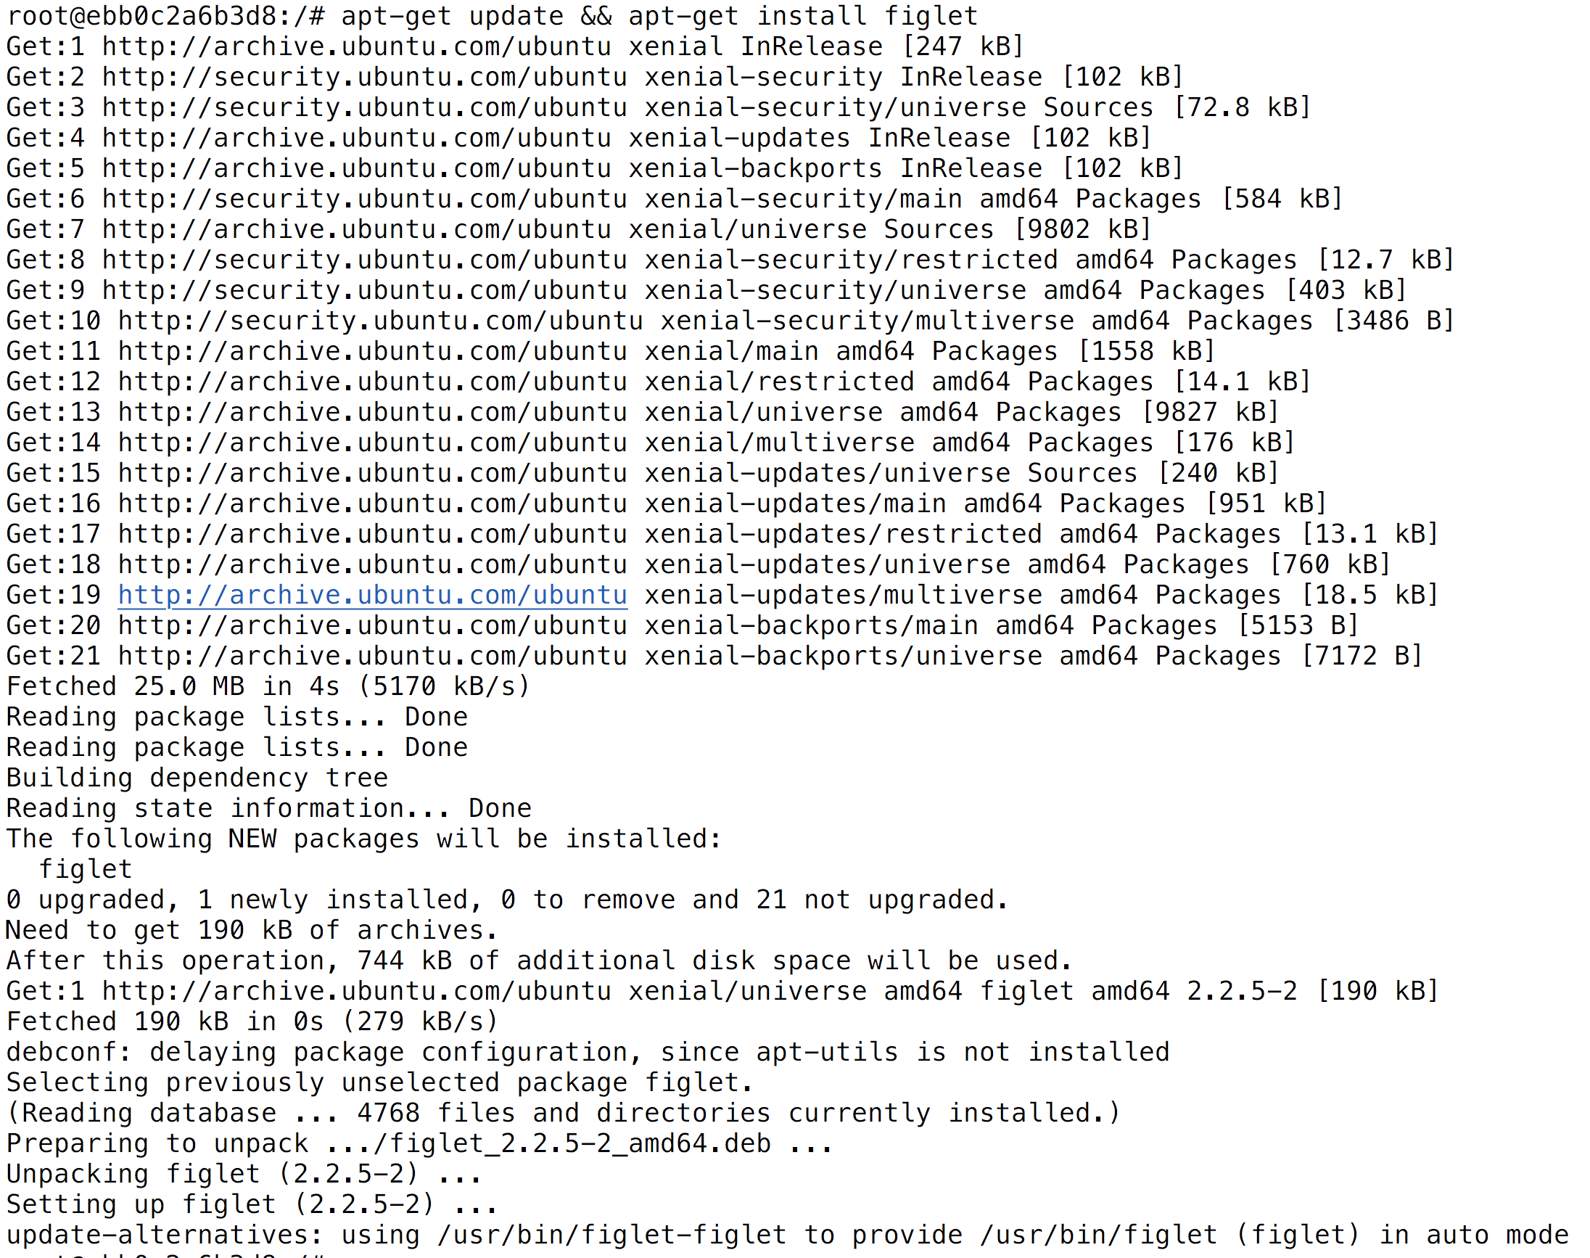
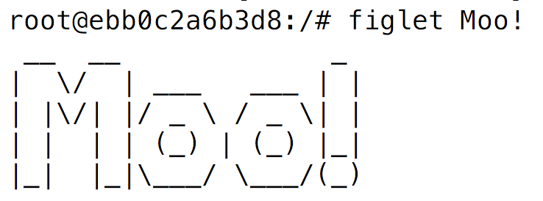
Ephemeral nature of containers
New Container == New Filesystem

Slide 37
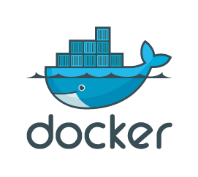


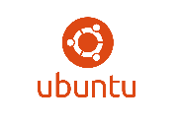
Container Host and Registry
Docker Hub
#docker run containerimage1
Docker Engine
Container
IMG1
Container
IMGn
Linux Kernel
Container 1n
Container 1m
Container
IMG1
Container
IMG1
Local Image Cache
Private Registry
Tools, Libs, SW
Tools, Libs, SW
Registry=
Habor.local
Registry=
Docker Hub
Container
IMG1
Container
IMGn
Linux “Container” Host
Harbor is included with VIC & PKS

Slide 38
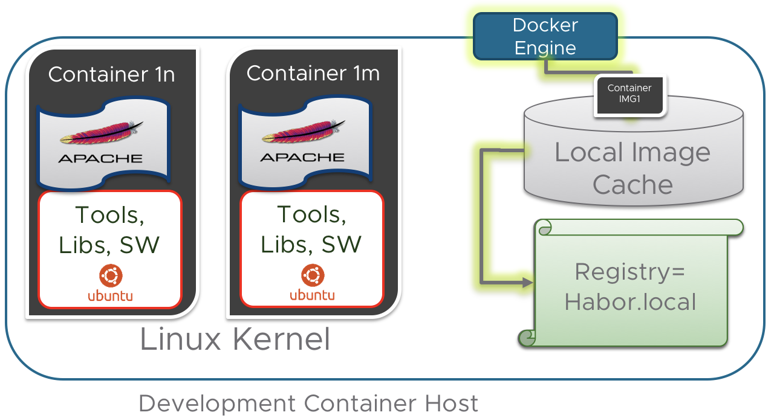

Running Basic Containers
Lets run the hello-world container against our developer environment and operations environment.
To do so, we need to alter our environment to point at alternative endpoints
docker run hello-world

Slide 39
Container Registry
Docker Engine
Linux Kernel
Container 1n
Container 1m
Container
IMG1
Container
IMG1
Local Image Cache
Tools, Libs, SW
Tools, Libs, SW
Registry=
Habor.local
Registry=
Docker Hub
Development Container Host

Slide 40
Container Registry
Docker Engine
Linux Kernel
Container 1n
Container 1m
Container
IMG1
Container
IMG1
Local Image Cache
Tools, Libs, SW
Tools, Libs, SW
Registry=
Habor.local
Registry=
Docker Hub
Production Container Host

Slide 41
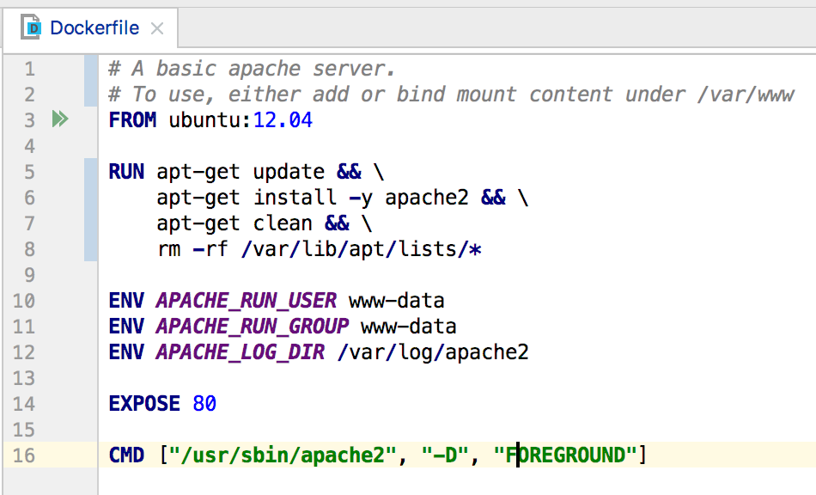
Docker Build
docker build -t 05-basic-dockerfile:latest . Sending build context to Docker daemon 46.59kB Step 1/7 : FROM ubuntu:12.04 ---> 5b117edd0b76 Step 2/7 : RUN apt-get update && apt-get install -y apache2 && apt-get clean && rm -rf /var/lib/apt/lists/* ---> Using cache ---> 88dde58a2f0b Step 3/7 : ENV APACHE_RUN_USER www-data ---> Using cache ---> 4049875bf83b Step 4/7 : ENV APACHE_RUN_GROUP www-data ---> Using cache ---> 0f8c759121c9 Step 5/7 : ENV APACHE_LOG_DIR /var/log/apache2 ---> Using cache ---> cea8f98bc3cf Step 6/7 : EXPOSE 80 ---> Using cache ---> 0619ee0963c2 Step 7/7 : CMD ["/usr/sbin/apache2", "-D", "FOREGROUND"] ---> Using cache ---> 8fa1657d73f1 Successfully built 8fa1657d73f1 Successfully tagged 05-basic-dockerfile:latest
Turn a Dockerfile into an image
VIC is not intended for development use. Docker build has not been implemented
Developers can build using their local docker instances and will push images to a central repository for broader consumption

Slide 42
Hands-On
Use the code from the git repository under 05-basic-dockerfile.
You will build an image based on an apache

Slide 43
Docker Tag
Store an Image in a Repository
docker tag SOURCE_IMAGE[:TAG] TARGET_IMAGE[:TAG]
docker tag 05-basic-dockerfile:latest 05-basic-dockerfile:v0.0.2
docker tag 05-basic-dockerfile:latest new-image-name:v0.0.3
docker tag 05-basic-dockerfile:latest vic.home.local/default-project/05-basic-dockerfile:v0.0.2
An Image name is a “/” separated string , possibly prefixed with a hostname
If there is no hostname component, a default of “registry-1.docker.io” is implied
A Tag name must be valid ASCII and may contain lowercase and uppercase letters, digits, underscores, periods and dashes. A tag name may not start with a period or a dash and may contain a maximum of 128 characters
The Image name and Tag name specify a specific image
A tag name of “latest” generally indicates the most recent build, and an image will generally also get tag name other than “latest”
A single image may be referenced by many image names and tags without making copies for the underlying image

Slide 44
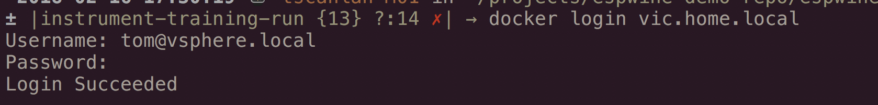
Docker Push
Store an Image in a Repository
Here we tag using a local repository host, vic.home.local
We login to that repository using credentials
Pushing the image sends a copy to the specified repository at the specified path
docker login vic.home.local
docker tag \
05-basic-dockerfile:latest \
vic.home.local/default-project/05-basic-dockerfile:latest
docker push vic.home.local/default-project/05-basic-dockerfile:latest
The push refers to repository [vic.home.local/default-project/05-basic-dockerfile] 8294b19bf3ee: Pushed 3efd1f7c01f6: Pushed 73b4683e66e8: Pushed ee60293db08f: Pushed 9dc188d975fd: Pushed 58bcc73dcf40: Pushed latest: digest: sha256:ce62a1f9adfa19ed9bb21f2b8caca49a72529b0e09e3c6fc5bbbf275b41d8fec size: 1571

Slide 45
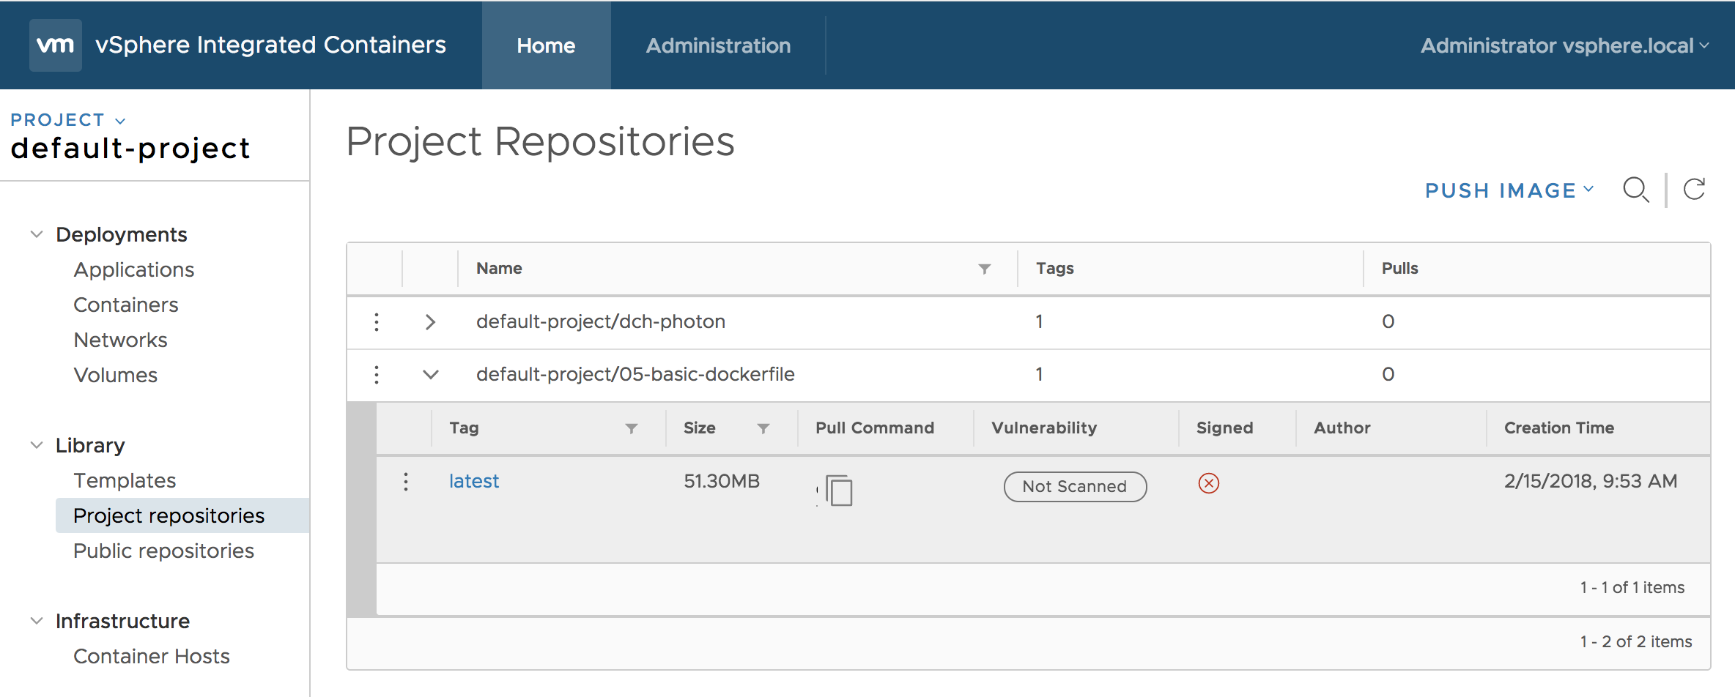
Check Image in Repository

Slide 46
Hands-on Build and Push
Make a simple Dockerfile
Build it into an image
Try running it
Tag it as for a local repository
Push it to store in the local repository

Slide 47
Working with images
Copy an image from a public repository to a local repository
Docker Hub
Here we diagram
Pulling an image to a local docker instance from a public registry
Tagging the image for a local repository
If authentication is needed against the local repository, login
Pushing the image to the local repository
docker pull jenkins/jenkins:lts
Local Docker Server
docker tag jenkins/jenkins:lts vic.home.local/jenkins/jenkins:lts
docker login vic.home.local
docker push vic.home.local/jenkins/jenkins:lts
Ops User
Secure Docker Registry

Slide 48
Operating Containers

Slide 49
Running Basic Containers
docker run hello-world

Slide 50
Running Basic Containers Hands-On
Get code from
https://github.com/tompscanlan/vmware-container-workshop

Slide 51
What is container orchestration
This is the term for automating the operation of container infrastructure and scheduling of running workloads
Orchestration touches on:
Handling container host registration and health monitoring
Scheduling of running containers on hosts that meet requirements
Restarting of failed or unhealthy containers
Keeping related workloads in close proximity
Persistant storage management
Exposeing services outside of the cluster
Scaling up or down services
Load balancing across scaled services

Slide 52
Deploying (Scheduling) Container ‘Apps’ (Multi-Container Based)

Slide 53
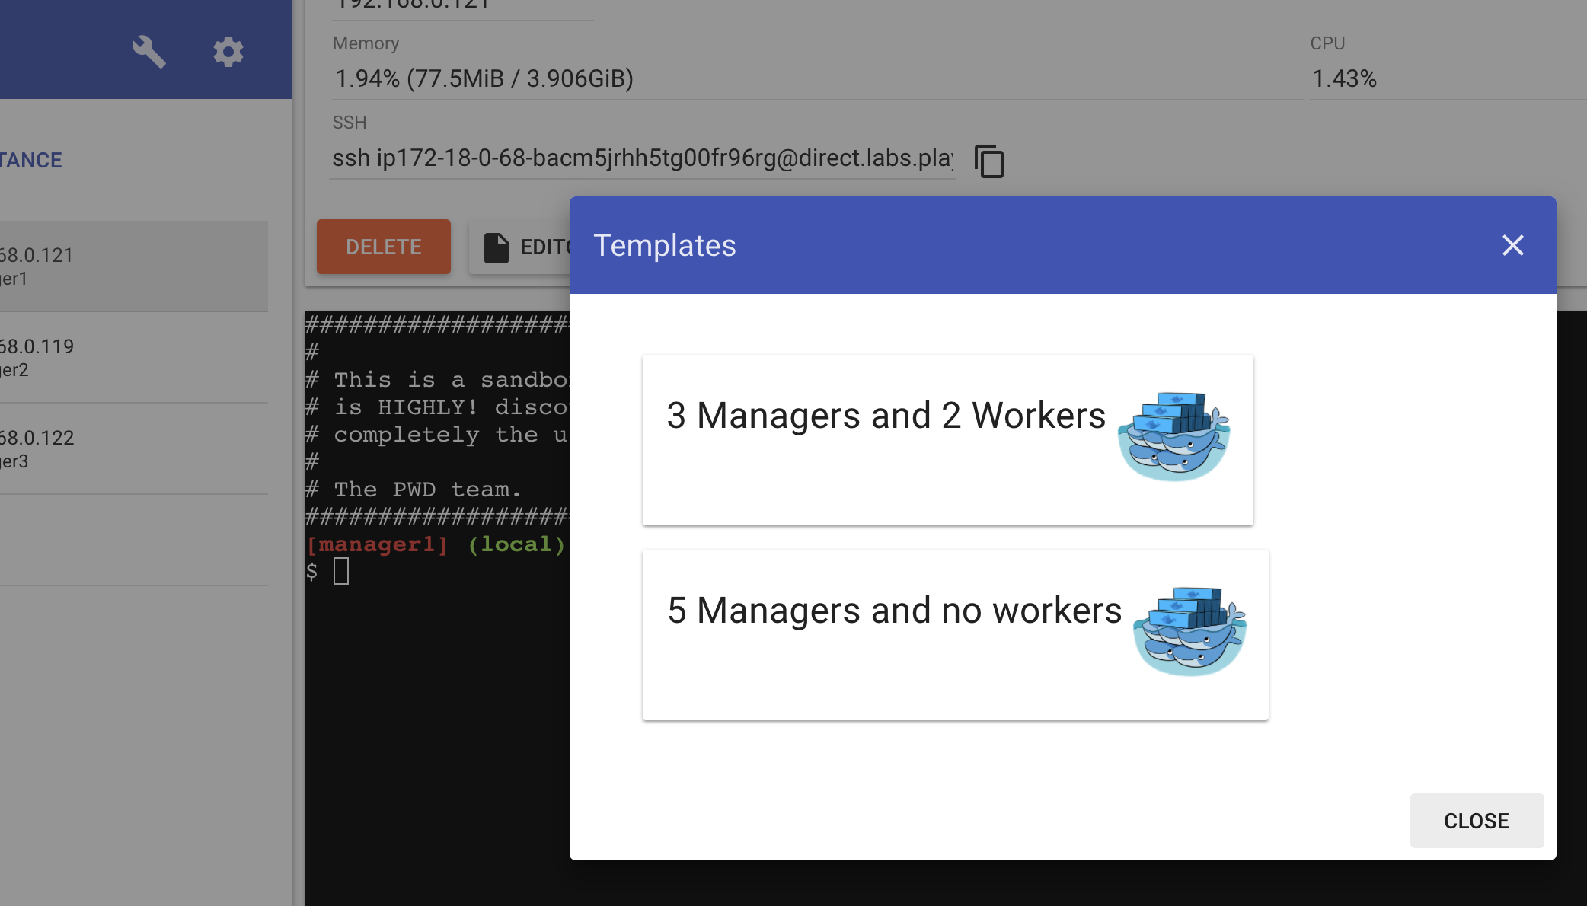
Hands-on with Swarm
Use the play with docker environment for local swarm testing: https://labs.play-with-docker.com
Click on the Wrench and select a 3 manager and 2 worker cluster
Then, either ssh into a master node or use the html based console

Slide 54
Hands-on with Kubernetes
Use the play with Kubernetes environment for Kubernetes testing: https://labs.play-with-k8s.com/

Slide 55
Kubernetes vs Swarm: General
Kubernetes
Installation
Complex, but automatable
Tenancy
Namespaces enable separating resources within the cluster
Secrets
Secrets per namespace enables easy configuration changes when moving an application across namespaces
Native cloud providers
Amazon EKS
Google GKE
Azure AKS
VMware vSphere via PKS
Century Link
IBM
Multi-cloud via stackpoint
Swarm
Installation
Fairly easy
Tenancy
Manual management of separate resources
Secrets
Single set of secrets across whole cluster
Cloud providers
Amazon
Azure
Others Manually
Multi-cloud via Docker Cloud

Slide 56
Kubernetes vs Swarm: Storage
Kubernetes
Volumes provided by storage backends
NFS
iSCSI
FC
Azure
AWS EBS
Ceph
Many more
Persistent Volumes and PV Requests
Allows requesting a type and size of storage (10GB SSD)
Any storage backend can dynamically fulfil the request
Swarm
Similar to Docker: Volumes
Volume Driver for other backends
NFS
iSCSI
FC
Azure
Ceph
Many more

Slide 57
Kubernetes vs Swarm: Services
Kubernetes
Application Lifecycle
Applications delivered as single or multi-container pods
Placement based on replica count requested, affinity and anti-affinity rules, and based on tags
Service and Deployments described by YAML
Service scaling manual or automated
Deployment updates via rolling-updates or re-create strategies
Healthchecks: liveness and readiness
Service Discovery
Via DNS addon
Via Environment Variables set at runtime
Swarm
Application Lifecycle
Applications delivered as services
Placement on all nodes, a set number of nodes, and placement by tags
YAML descriptions of services
Service scaling manually
Updates via rolling-update strategy
Healthchecks limited to services
Service Discovery
Unique DNS name per service
DNS based loadbalancing

Slide 58
Kubernetes vs Swarm: Networking
Kubernetes
Networking
Flat network, all pods can talk to any pod
Flat network is generally provided via an overlay network, many options in this layer
Policies can control cross pod communication
Requires once CIDR for pod addresses and one for service addresses
Swarm
Networking
An overlay network is created for services when nodes join the cluster, containers remain isolated to the host
Overlay and management traffic can be encrypted

Slide 59
Storage

Slide 60
Image layers
A Docker image is built up from a stack of layers
Each layer contains the changes made to the filesystem as defined by a single line in the Dockerfile
All layers are read-only, except for the last layer which is read-write and sometimes called the container layer
The container layer holds all changes made to the filesystem during runtime, and those changes are lost if the container is removed
Many running containers can use the same read-only layers, but each will have it’s own container layer
Storage drivers handle details of how the layers interact

Slide 61
Persistent Storage
Container writable layers can be used to store data, but this is an anti-pattern
Instead use one of the following storage options:
Bind Mounts: may be stored anywhere on the host system. They may even be important system files or directories. Non-Docker processes on the Docker host or a Docker container can modify them at any time
Tmpfs Mounts: are stored in the host system’s memory only, and are never written to the host system’s filesystem
Volumes: are stored in a part of the host filesystem which is managed by Docker (/var/lib/docker/volumes/ on Linux). Non-Docker processes should not modify this part of the filesystem. Volumes are the best way to persist data in Docker.

Slide 62
Volumes
Volumes are filesystems that can be attached to running containers
https://vmware.github.io/vic-product/assets/files/html/1.3/vic_app_dev/using_volumes_with_vic.html

Slide 63
Image layers
docker images -a REPOSITORY TAG IMAGE ID CREATED SIZE 05-basic-dockerfile latest 8fa1657d73f1 17 minutes ago 150MB <none> <none> 0619ee0963c2 17 minutes ago 150MB <none> <none> cea8f98bc3cf 17 minutes ago 150MB <none> <none> 4049875bf83b 17 minutes ago 150MB <none> <none> 88dde58a2f0b 17 minutes ago 150MB <none> <none> 0f8c759121c9 17 minutes ago 150MB ubuntu 12.04 5b117edd0b76 10 months ago 104MB
docker history 05-basic-dockerfile:latest IMAGE CREATED CREATED BY SIZE COMMENT 8fa1657d73f1 42 minutes ago /bin/sh -c #(nop) CMD ["/usr/sbin/apache2" … 0B 0619ee0963c2 42 minutes ago /bin/sh -c #(nop) EXPOSE 80 0B cea8f98bc3cf 42 minutes ago /bin/sh -c #(nop) ENV APACHE_LOG_DIR=/var/l… 0B 0f8c759121c9 42 minutes ago /bin/sh -c #(nop) ENV APACHE_RUN_GROUP=www-… 0B 4049875bf83b 42 minutes ago /bin/sh -c #(nop) ENV APACHE_RUN_USER=www-d… 0B 88dde58a2f0b 42 minutes ago /bin/sh -c apt-get update && apt-get ins… 46.8MB 5b117edd0b76 10 months ago /bin/sh -c #(nop) CMD ["/bin/bash"] 0B <missing> 10 months ago /bin/sh -c mkdir -p /run/systemd && echo 'do… 7B <missing> 10 months ago /bin/sh -c sed -i 's/^#\s*\(deb.*universe\)$… 1.91kB <missing> 10 months ago /bin/sh -c rm -rf /var/lib/apt/lists/* 0B <missing> 10 months ago /bin/sh -c set -xe && echo '#!/bin/sh' > /… 156kB <missing> 10 months ago /bin/sh -c #(nop) ADD file:6f12126281dd0028d… 103MB

Slide 64


Images
Containers are launched from images
Images are not virtual disks
Images are multilayer templates that are used to instantiate containers
Docker uses a union filesystem to present layers as single storage
Images are pulled from public or private docker registries
Docker host
docker pull httpd
docker pull nginx
alpine
redis
nginx
nginx
httpd
httpd

Slide 65
Bare metal or VM
Container
Container
Container
Container
httpd
httpd
nginx
redis
docker image ls
docker run httpd
docker run httpd
docker run nginx
docker run redis
Copy on Write Layer
Docker Engine
Linux OS
redis
nginx
httpd

Slide 66
Bare metal or VM
docker volume create –-driver=…
docker run –v volume:/data redis
Container
Container
Container
Container
httpd
httpd
nginx
redis
local dir
nfs
/data
Copy on Write Layer
EBS
Docker Engine
volume
flocker
vDVS
VMDK
Linux OS
Volumes are provided by volume drivers
EBS, flocker, vDVS etc require 3rd party volume drivers

Slide 67
Scale Out Needs Storage Orchestration
Volume definitions local to each host
Volume drivers need to be present on each host
Containers need to be able to live and die – containers themselves best to be ephemeral
Bare metal or VM
Bare metal or VM
Bare metal or VM
Container
Container
Container
Container
Container
Container
Container
Container
Container
Container
Container
Container
httpd
httpd
nginx
redis
httpd
httpd
nginx
redis
httpd
httpd
nginx
redis
/data
/data
/data
Copy on Write Layer
Copy on Write Layer
Copy on Write Layer
Docker Engine
Docker Engine
Docker Engine
Linux OS
Linux OS
Linux OS

Slide 68
How Does Kubernetes Do It?

Slide 69
Kubernetes Solves Persistence with Persistent Volumes
Images are pulled and copy-on-write layers are used as before
Separate the definition of the storage from the container consumption
More abstraction!!
Cloud admin can create a persistent volume using a variety of persistent volume providers
Developer can request a persistent volume claim
Persistent Volume
K8s Pod
Persistent Volume Claim
httpd
Ceph
GCE Persistent Disk
AWS EBS
AzureDisk
NFS
iSCSI
Cinder
vSphere
Persistent Volume Types

Slide 70
mypod
Persistent Volume
Persistent Volume Claim
httpd
kind: pod
apiVersion: v1
metadata:
name: mypod
spec:
containers:
- name: myfrontend
image: repo/httpd
volumeMounts:
- mountPath: “/var/www/html
name: mypd
volumes:
- name: mypd
persistentVolumeClaim:
claimName: myclaim
kind: PersistentVolumeClaim
apiVersion: v1
metadata:
name: myclaim
spec:
accessModes:
- ReadWriteOnce
resources:
requests:
storage: 8Gi
storageClassName: slow
selector:
matchLabels:
vol-type: nfs
kind: PersistentVolume
apiVersion: v1
metadata:
name: pv0003
labels:
vol-type: nfs
spec:
capacity:
storage: 5Gi
accessModes:
- ReadWriteOnce
persistentVolumeReclaimPolicy: Recycle
storageClassName: slow
nfs:
path: /tmp
server: 172.17.0.2

Slide 71
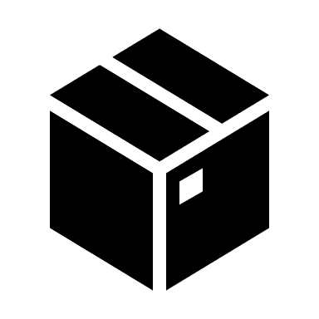
Kubernetes Master
etcd K/V Store
Kubernetes Node
kubelet
kind: PersistentVolume
apiVersion: v1
metadata:
name: pv0003
vol-type: nfs
spec:
capacity:
storage: 5Gi
accessModes:
- ReadWriteOnce
persistentVolumeReclaimPolicy: Recycle
storageClassName: slow
mountOptions:
- hard
- nfsvers=4.1
nfs:
path: /tmp
server: 172.17.0.2
kind: PersistentVolumeClaim
apiVersion: v1
metadata:
name: myclaim
spec:
accessModes:
- ReadWriteOnce
resources:
requests:
storage: 8Gi
storageClassName: slow
selector:
matchLabels:
voltype: nfs
kind: pod
apiVersion: v1
metadata:
name: mypod
spec:
containers:
- name: myfrontend
image: repo/httpd
volumeMounts:
- mountPath: “/var/www/html
name: mypd
volumes:
- name: mypd
persistentVolumeClaim:
claimName: myclaim
Kubernetes Node
kubelet
api server
scheduler
Kubernetes Node
kubelet
mypod
httpd
kubectl create –f persistentvol.yml
kubectl create –f persistentvolclaim.yml
kubectl create –f pod.yml
nfs

Slide 72

Docker Default Networking
Default Docker net behaviour is containers connected to the bridge network
10.240.0.3
172.17.0.1
int eth0
int docker0
172.17.0.2
172.17.0.3
172.17.0.4
bridge
Docker Host
Notes:
This is the default bridge network
Run ifconfig on the container host to see
The containers each get a virtual Ethernet interface (vethXXX) which connects through docker0
This is default behaviour
Containers don’t have to connect to this bridge
docker run --network=<NETWORK> can be used to override
What networks are there on container host?
To list the networks: docker network ls
Bridge, none, host
The none network allows a container to be added to a container specific stack
If you ran ifconfig inside a Linux container that was connected to “none”, you would only have loopback interface
The host network adds the container to the host’s network stack with no isolation between host machine and container
E.g. use port 80 on container, is using port 80 on the host
The none and host networks are not directly configurable
The docker0 bridge network can be modified with docker inspect bridge

Slide 73
Network Interfaces Inside & Out
Container “nginx”
Container “httpd”
Container Network Namespace
eth0
Container Network Namespace
eth0
veth pair
veth1
veth2
docker0
Root network namespace
eth0
Docker Host

Slide 74
Port Expose and Port Publish
If the EXPOSE option is used in the Dockerfile
The app in the container is accessible on that port
But only to other containers
To publish the port we make a port redirect on the host
docker run -p:8080:80
Publish implicitly exposes
10.240.0.3:8080
10.240.0.3:8081
10.240.0.3
172.17.0.1
int eth0
int docker0
172.17.0.2
172.17.0.3
172.17.0.4
Listening on port 80
Listening on port 80
Docker Host

Slide 75
Adding Docker Networks
You can also create your own networks
docker network create …
You could give a container an interface on a real network using sub-interfaces
eth0.vlan100, eth0.vlan200 etc
This can be with IPVLAN or MACVLAN drivers
IPVLAN: containers all share MAC of eth0
MACVLAN provides each container with unique IP and MAC
Requires IEEE 802.1q trunk port for eth0
172.17.0.1
int eth0
int docker0
eth0.vlan100
eth0.vlan200
192.168.0.33
10.0.77
Docker Host
Notes:
This is the default bridge network
Run ifconfig on the container host to see
The containers each get a virtual Ethernet interface (vethXXX) which connects through docker0
This is default behaviour
Containers don’t have to connect to this bridge
docker run --network=<NETWORK> can be used to override
What networks are there on container host?
To list the networks: docker network ls
Bridge, none, host
The none network allows a container to be added to a container specific stack
If you ran ifconfig inside a Linux container that was connected to “none”, you would only have loopback interface
The host network adds the container to the host’s network stack with no isolation between host machine and container
E.g. use port 80 on container, is using port 80 on the host
The none and host networks are not directly configurable
The docker0 bridge network can be modified with docker inspect bridge

Slide 76
Multiple Hosts
10.240.0.3:8080
10.240.0.4:8080
10.240.0.3
172.17.0.1
10.240.0.4
172.17.0.1
int eth0
int docker0
int eth0
int docker0
172.17.0.2
172.17.0.3
172.17.0.4
172.17.0.2
172.17.0.3
172.17.0.4
c1
c2
c3
c4
c5
c6
Listening on port 80
Listening on port 80
Docker Host 1
Docker Host 2

Slide 77
Default Docker Network Model Doesn’t Scale
10.240.0.3:8080
10.240.0.4:8080
10.240.0.5:5000
10.240.0.6:8001
int eth0
10.240.0.3
172.17.0.1
int eth0
10.240.0.4
172.17.0.1
int eth0
10.240.0.5
172.17.0.1
int eth0
10.240.0.6
172.17.0.1
int docker0
int docker0
int docker0
int docker0
c1
c2
c3
c4
c5
c6
c7
c8
c9
c10
c11
Docker Host 1
Docker Host 2
Docker Host 3
Docker Host 4
Notes:
Think about autoscaling up or down (more containers)
Think about adding more nodes – shouldn’t care in app
Think about new micro-services – we don’t care about underlying we just want app to deliver service

Slide 78
Container Orchestration Platform Needed!
There are a number of ways to provide scalable software-defined container networks
Docker’s own native orchestration is called Docker Swarm
You create a cluster of Docker Hosts
You create overlay network (which implements VXLAN)
You deploy services which describe the replica count of container image
Notes:
or plug-in network providers

Slide 79
Docker Native Overlay
Container “nginx1”
Container “nginx2”
eth1
eth0
eth0
eth1
veth
my_overlay
Overlay (VXLAN)
veth
my_overlay
veth
docker_gwbridge
docker_gwbridge
veth
eth0
eth0
Docker Host
Docker Host

Slide 80
So How Does Kubernetes Do It?
Notes:
But as we are learning VMware PKS, our container orchestration platform is Kubernetes
Kubernetes can use container runtime of Docker or rckt
Kubernetes networking is implemented using CNI specification rather than Docker native CNM specification

Slide 81
Kubernetes Imposes Network Requirements
The K8s network model requires that:
all containers can communicate with all other containers without NAT
all nodes can communicate with all containers (and vice-versa) without NAT
the IP that a container sees itself as is the same IP that others see it as
This model is less complex
Compatible with the desire for Kubernetes to enable low-friction porting of apps from VMs to containers
If your job previously ran in a VM
Your VM had an IP and could talk to other VMs in your project
This is the same basic model

Slide 82


Kubernetes Default Networking
The docker0 default bridge is still present but not used
A new interface cbr0 is created on the node
The node maintains a unique IP address range for its pods
Nodes are controlled from the master
Each pod gets an IP from this range
Routed access out cbr0 → eth0
10.240.0.3
172.17.0.1
int eth0
int docker0
int cbr0
10.24.1.1/24
10.24.1.2
10.24.1.3
10.24.1.4
Kubernetes Node (a docker host)

Slide 83
Kubernetes Default Networking
10.240.0.3
172.17.0.1
10.240.0.4
172.17.0.1
int eth0
int docker0
int eth0
int docker0
int cbr0
10.24.1.1/24
int cbr0
10.24.2.1/24
10.24.1.2
10.24.1.3
10.24.1.4
10.24.2.2
10.24.2.3
10.24.2.4
Kubernetes Node (a docker host)
Kubernetes Node (a docker host)
ip route 10.24.1.0/24 10.240.0.3
ip route 10.24.2.0/24 10.240.0.4

Slide 84
Kubernetes Network Add-ons
Cilium
Contiv
Contrail
Flannel
Nuage Networks VCS
OpenVSwitch
Open Virtual Network (OVN)
Project Calico
Romana
Weave
While these networking add-ons help, there is already a killer SDN solution on the market…
NSX-T!
NSX-T 2.0 provides K8s network add-on
Enables containers to get all the NSX benefits
Overlay, micro-segmentation, monitoring
VMware PKS includes NSX-T

Slide 85
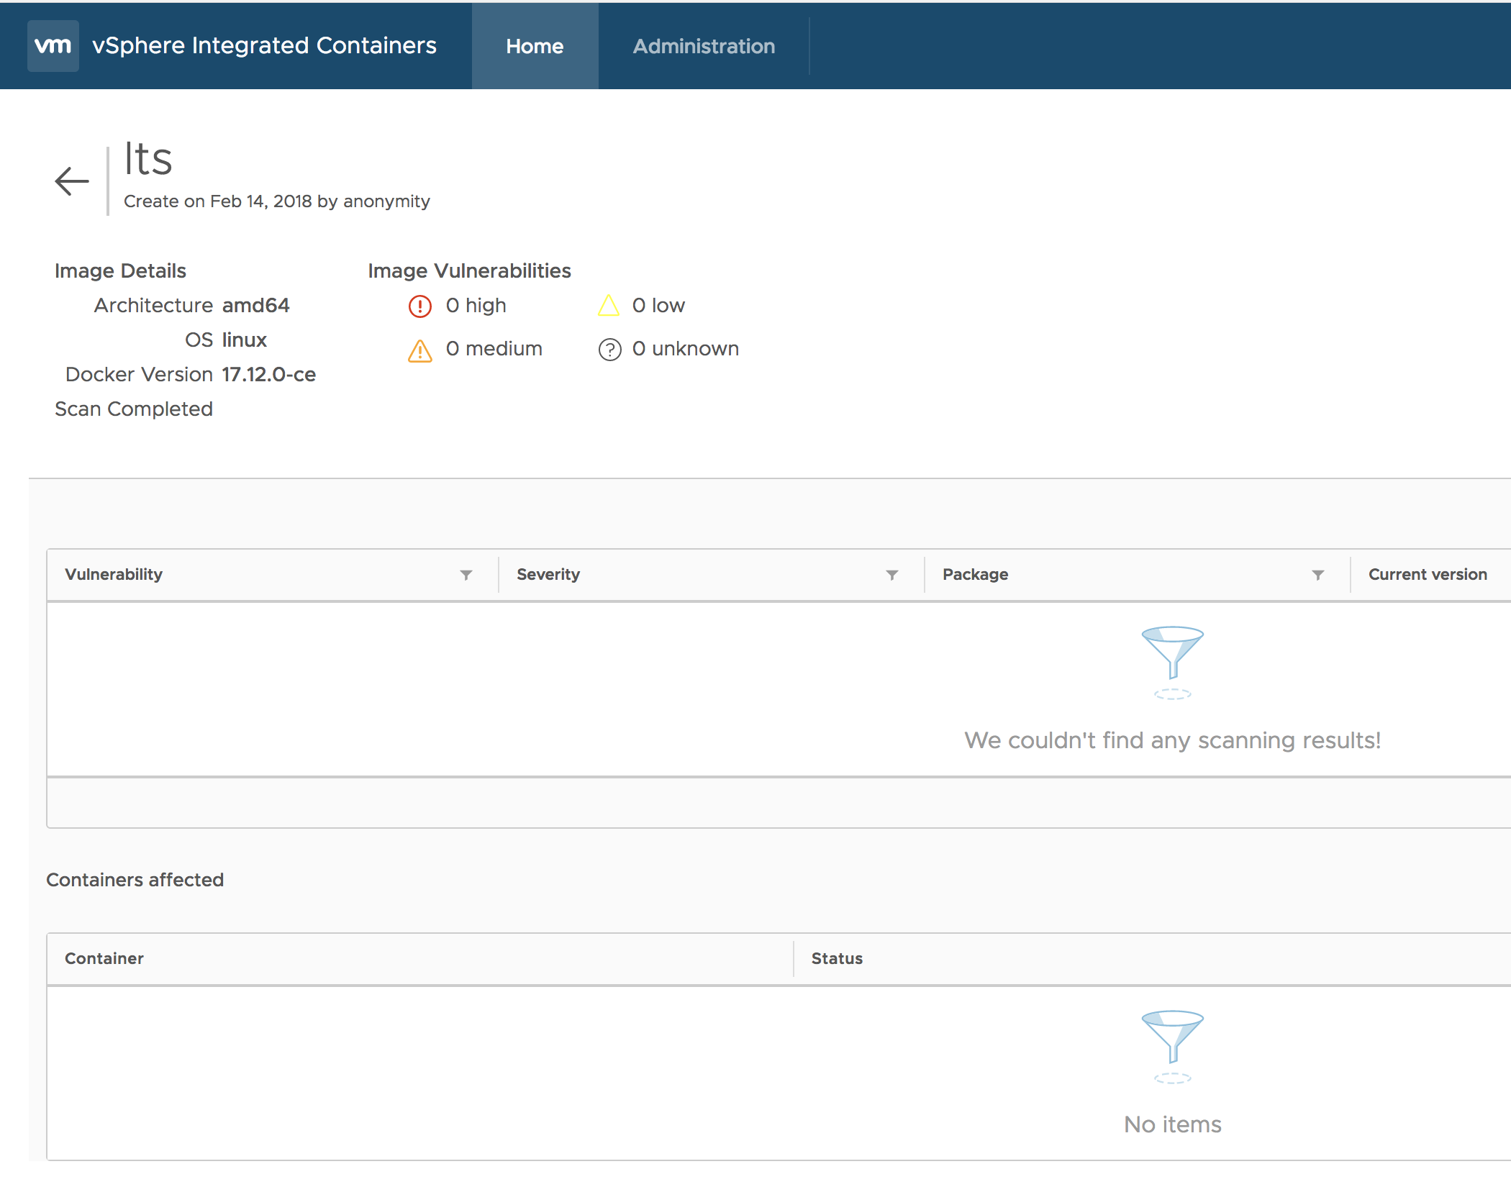
Scanning Images for Vulnerabilities

Slide 86
Developer Workflow
Hands-on
Archive
Harbor Registry
Jenkins or
Concourse
Trigger Build
Git Repository
Build, Test
Push Code
Developer
Build App
Build Container
Test App in Container
Push to Registry
Watch for build errors

Slide 87
Continuous Deployment
Hands-on
Build App
Build Container
Test App in Container
Push to Registry
Jenkins or
Concourse
Harbor Registry
Git Repository
Harbor Registry
Developer
SRE or
Operator

Slide 88
Continuous Integration and Continuous Deployment
Hands-on
Deploy Jenkins to your local dev box
https://github.com/tompscanlan/vmware-container-workshop/tree/master/15-run-jenkins

Slide 89
Phases of Container Adoption

Slide 90
Repackaging Existing Applications
The simplest and fastest way to achieve operational efficiency with containers
Convert existing Apps or App Components into containers
Significant operational benefits can often be gained by containerizing:
Ease of upgrading (better portability as apps move from dev to test to prod)
Simplified patch management/compliance (easily rebuild images using dockerfiles, clear traceability with immutable images)
Simplified CI/CD integration
Use of container workflows
Application repackaging does not aim to change the application architecture. No new application platform or framework needed
Moving service dependencies to containers enables smaller footprint applications

Slide 91
Replatforming
This is taking a containerized application and leveraging an orchestrator to manage the lifecycle of that application
Take an existing application:
containerize it
move it to a new container framework like Kubernetes
Replatforming can provide consolidation benefits allowing you to modernize traditional applications and run them on the same container framework as true cloud-native applications

Slide 92
Application Refactoring
Involves re-architecting all or parts of a monolithic application
Embrace 12 factor pattern
Produce distributed, microservices-based, stateless apps that interact
Refactoring large monoliths provides benefits such as better scalability and availability, but often can be quite resource intensive.
Usual pattern is to incrementally refactor monolithic apps into microservices
new functionality is exclusively microservices
converting existing modules into microservices over time

Slide 93
Cloud-Native Applications First
When working in a greenfield situation, start with CNA patterns in mind
Cloud-Native Applications are designed for availability and scalability. As in app refactoring, cloud-native apps are distributed, microservices-based, stateless, and highly orchestrated.

Slide 94
How Does Linux Boot
In a nutshell . . .
First, the bootloader code executes, loads the kernel (from disk, net, or whevever).
After a bunch of hardware “setup” by the kernel, the kernel calls the “init” program.
The “init” program (usually) starts all the processes in the system.
TCP/IP stuff, like DHCP clients for IP addresses.
Web Servers (if we want those).
Databases (if we want those).
That’s about it (in a nutshell, though – there is more to it but that’s enough).

Slide 95
How Does a VM Boot?
In a nutshell . . .
We boot Linux (ESXi or KVM, as in the last slide, which starts the “hypervisor”).
This kernel (hypervisor), though, has a bunch of special “drivers” that “virtualize” the hardware.
Effectively, we insert a “shim” between special (VM) processes and actual hardware, so the VM believes it’s talking to actual hardware.
The drivers multiplex the VMs appropriately and do a bunch of other work to make sure they don’t collide or see each other “in memory”.
A process (maybe by ”init”) is started that sets up isolation for the VM (disk, memory, and so on).
The kernel ‘boots’ the new VM.
Basically, starts an emulated BIOS, which sees disk files as disks (i.e., vmdks), tricked drivers as network cards (vmnics), and so on.
The “inner” kernel boots just like normal (see the previous slide).
That’s about it (in a very small nutshell, though).
The point is, hypervisor starts a BIOS that looks just like a machine (virtual) so it’s full virtualization.

Slide 96
How Does a Container Boot?
Trick Question… it doesn’t
Linux boots, but only needs to start some container manager
We ask the container manager to ‘start/run’ a container:
Container manager ‘creates a new namespace’, which is effectively ‘the container’:
A namespace is a kernel trick to ‘keep things grouped and isolated’ so it can treat the ’group of things’ as a contained set of things to manage.
This includes things like ‘a file system’ (which is just a directory somewhere on the disk that the kernel knows ‘belongs’ to the container (namespace)), ’virtual network cards’ (which are just pipes that have one end ‘in’ the container and one end ‘on a virtual switch’, processes (which are programs that run ‘in the container’).
So when we say ‘in a container’ we simply mean ‘in that namespace the kernel knows is our stuff and only our stuff’
Container manager unpacks the ‘container image’ (which is not all that different than a vmdk) into the ’directory’ that is the file system for the container.
The container manager tells the kernel to execute a program that exists on that ‘container image’ that is now unpacked into the ‘isolated’ directory.
That’s it (again, in a nutshell, because there are things like ’cgroups’ that let us dictate the ‘namespace’ (i.e., contained things) can only use so much CPU, network bandwidth, and so on.
The larger point is, containers are just ‘isolated process/disk directory/virtual Ethernet pipes, users, and so on. where the isolation is purely a kernel namespace and ‘quota/cgroup’ trick.

Slide 97
Deploying or Scheduling Container Apps
Multi-Container Based

Slide 98





What is Important to Devs and Ops
Developers Like
Ops Needs
Portable
Fast
Light
Secure
Network
Data Persistence
Consistent
Management
Rapid start times
&
Control
Minimal Configuration and footprint
Ability to move
Dev→ Test → Prod
Meet
security
standards
Hook into
existing
network
Access to the “state” of the app
Single
pane of
glass

